Slide 1
DATA WAREHOUSE DESIGN APPROACH : INMON Vs KIMBALL

Slide 2
Inmon's Approach
William H. Inmon known as the "Father of Data Warehousing" proposed a top-down approach
Data collected from various OLTP data source are cleaned and transformed (ETL) by the organization before storing in the data warehouse. Creating definite ,consistent representation of organizational data.
Building the enterprise data warehouse. Core idea is to create a central repository of data integrated from all organizational systems.
Data stored is normalized so there will be no data inconsistency and data redundancy. So lesser storage is required.
Data is filtered and subsets of data is sent to business focused data mart for different operations of organizations. This data is used for analytical and reporting purposes.

Slide 3
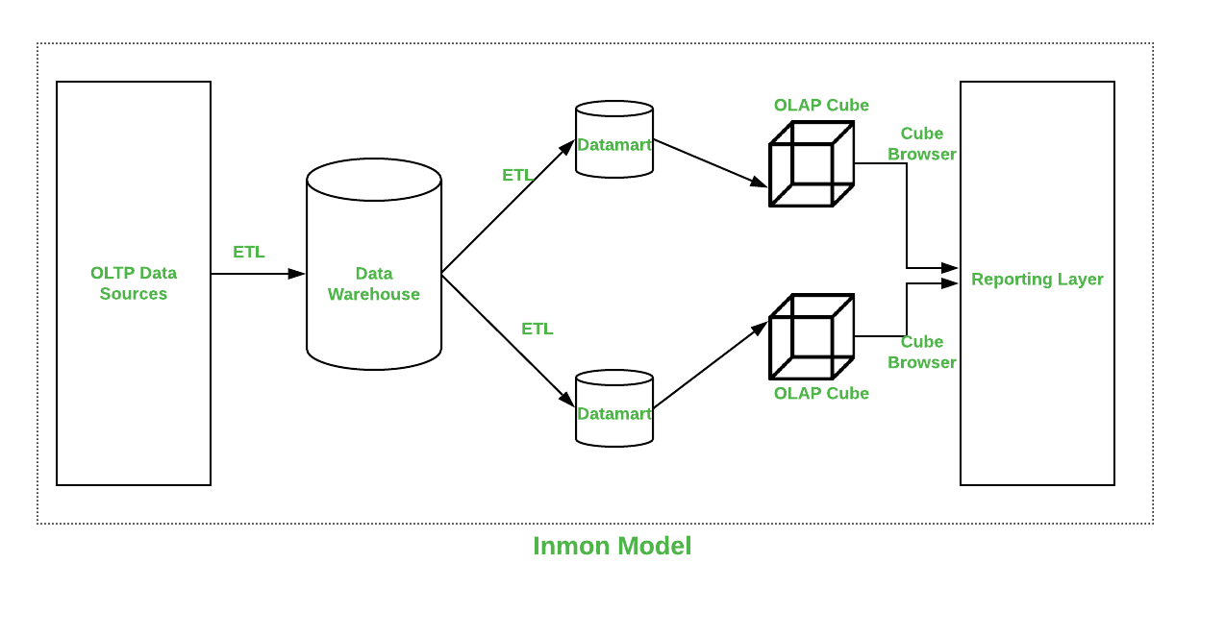

Slide 4
Advantages : Enterprise focused Single Source of Truth Lesser data redundancy and inconsistency Easier to model since data is normalized Scalability Easier maintenance
Disadvantages : Longer delivery time Large number joins are required for normalization of data

Slide 5
Kimball's Approach
Ralph Kimball proposed a bottom-up approach
.Data from various OLTP sources are collected by various business focused data marts who conduct the ETL process.
Data is stored in a less normalized structure. Star schema consist of central fact table and dimensional table connected to the fact table using keys. Multiple star schemas are connected to each other using keys.
This highly denormalized data is stored in a dimensional data warehouse. For analysis and reporting purpose required star schema is collected from data warehouse.

Slide 6
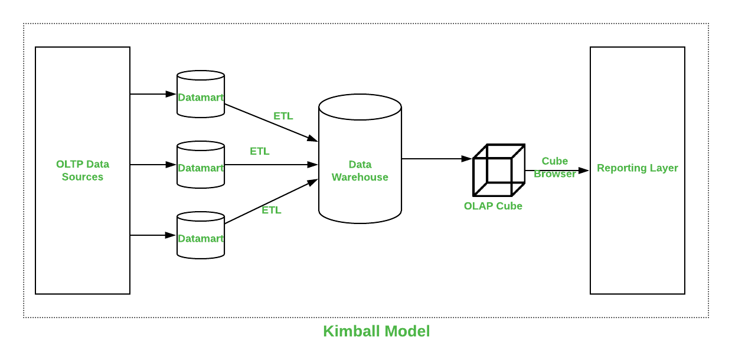

Slide 7
Advantages : Business focused Quicker delivery Ease of use Lesser time for setup
Disadvantages : Complex ETL process for denormalization More storage requirement. Duplicate data present in data marts Challenging maintenance.

Slide 8
Comparison
 | INMON | KIMBALL
Approach | It has a Bottom-Up Approach for implementation. | It has Top-Down Approach for implementation.
Data Integration | It focuses on Individual business areas. | It focuses on Enterprise-wide areas.
Building Time | It is efficient and takes less time. | It is complex and consumes a lot of time.
Cost | It has iterative steps and is cost-effective. | Initial cost is huge, and the development cost is low.
Skills Required | It does not need such skills, but a generic team will do the job. | It needs specialized skills to make work.
Maintenance | Here maintenance is difficult. | Here maintenance is easy.
Data Model | It prefers data to be in the De-normalized model. | It prefers data to be in a normalized model.
Data Store Systems | In this, source systems are highly stable. | In this, source systems have a high rate of change.

